Slide 1


Network Security
Firewalls, Intrusion Prevention, VPN Tunnels, Segmentation & ACL Logic

Slide 2




Firewall Core Types & State Tracking
Stateless Firewalls
Stateful Firewalls
Operation: Filters packets independently based solely on Layer 3 and Layer 4 static header values (IPs, Ports, Protocols).
Operation: Tracks TCP handshakes and active session contexts in a real-time dynamic State Table.
Key Trait: Automatically allows return traffic for validated established connections without explicit inbound rules.
Key Trait: Evaluates each packet in isolation without maintaining session history or connection tables.
Advantage: Prevents unsolicited probe packets, detects illegal sequence numbers, and simplifies policy tables.
Limitation: Vulnerable to IP spoofing and ACK-scan bypasses; requires manual dual-direction rule definitions.

Slide 3
Firewall Generations Comparison
Capability Feature | Stateless (ACL Router) | Stateful Inspection | Next-Gen (NGFW)
OSI Layer Inspection | Layer 3 / Layer 4 | Layer 3 / Layer 4 + Session | Layer 3 through Layer 7
State Table Tracking | No State Table | TCP/UDP State Table | State + App Context
Deep Payload Inspection | None (Headers Only) | Header & Handshake Only | Full DPI & Malware Scan
App & Identity Awareness | Port-based only | Port-based only | App-ID & User-ID mapping
Performance Profile | Ultra High (Hardware wire speed) | High (Low latency) | Moderate to High (DPI engine)

Slide 4


IDS vs IPS Architectural Deployment
Detection vs Prevention Mechanisms
▹
IDS (Intrusion Detection System): Deployed out-of-band via SPAN/TAP ports. Passive monitoring produces alerts without introducing inline latency.
▹
IPS (Intrusion Prevention System): Deployed inline directly along traffic flow. Actively blocks malicious packets, drops connections, and resets TCP sessions.
▹
Response Speed: IDS requires SOC analyst or automated SIEM playbook intervention; IPS executes automated real-time inline mitigation.
▹
Risk Tradeoff: IPS misconfigurations risk blocking legitimate business traffic (false positive impacts productivity).

Slide 5









IDS/IPS Detection Engines
Signature-Based
Anomaly-Based
Behavioral Heuristics
Matches traffic against database of known exploit patterns & hash signatures. High accuracy with minimal false positives, but completely blind to zero-day vulnerabilities.
Establishes baseline normal network behavior and triggers alerts on statistical deviations. Detects novel zero-day threats, but incurs higher false positive rates.
Combines machine learning rules with protocol analysis to identify suspicious actions (e.g., rapid port scans or DNS tunneling) regardless of payload signature.

Slide 6

VPN Tunnels & Protocols
Securing Data in Transit
Virtual Private Networks create encrypted tunnels across untrusted transit networks, ensuring Confidentiality, Integrity, and Authentication.
Site-to-Site VPNs: Interconnect static corporate offices using IPsec (IKEv2) hardware gateways with ESP encryption.
Remote Access VPNs: Connect mobile users to internal gateways using SSL/TLS (OpenVPN) or modern WireGuard protocols.

Slide 7
Critical VPN Misconfigurations
Legacy Ciphers & Broken Hashing: Enabling outdated crypto suites like 3DES, RC4, or MD5 allows session decryption and man-in-the-middle attacks.
Weak Pre-Shared Keys (PSK): Utilizing low-entropy static passwords for IPsec Phase 1 negotiation makes tunnels vulnerable to offline dictionary brute-forcing.
Uncontrolled Split Tunneling: Allowing endpoint internet traffic to bypass the VPN tunnel exposes client devices to malware while bridging internal networks.
Missing Perfect Forward Secrecy (PFS): Disabling Diffie-Hellman re-keying guarantees that compromised long-term private keys decrypt all historical recorded session traffic.

Slide 8




Proxies & Network Segmentation
Proxy Server Filtering
Segmentation & DMZ
Forward Proxy: Sits on client perimeter to inspect outgoing requests, filter URLs, terminate SSL for scanning, and block unauthorized data exfiltration.
VLAN & Subnet Isolation: Divides physical networks into distinct security zones (DMZ, Internal App, Database, Management) to prevent lateral attacker movement.
Reverse Proxy: Positioned in front of servers to perform web application firewalling (WAF), load balancing, and hide internal network topology.
Zero-Trust Microsegmentation: Enforces granular east-west security policies down to individual workloads, restricting unauthorized peer communication.

Slide 9

ACL Logic: Top-Down Rule Processing
First-Match Execution Engine
0
Access Control Lists (ACLs) process incoming packets strictly sequentially from top to bottom based on line number.
1. First Match Standard: As soon as a packet matches a rule's parameters, that action (Permit/Deny) executes instantly; evaluation stops.
Implicit Deny Any Any Rule
2. Specificity Rule: Specific host/port rules MUST be placed above broad network range rules to avoid unintended overrides.
3. Default Fallback: Any traffic not explicitly allowed by preceding rules hits Rule 0 (Implicit Deny) and is silently dropped.

Slide 10
Packet Filtering ACL Matrix
Rule ID | Action | Protocol | Source IP | Dest IP / Port | Operational Intent
10 | PERMIT | TCP | 10.0.1.0/24 | 192.168.1.10:443 | Allow LAN access to internal HTTPS Server
20 | PERMIT | TCP | 10.0.1.50/32 | 192.168.1.5:22 | Allow Admin Workstation SSH to Management Server
30 | DENY | TCP | ANY | 192.168.1.0/24:22 | Block SSH attempts from all other sources
40 | DENY | ICMP | ANY (External) | ANY (Internal) | Block external ping sweep reconnaissance
999 | DENY | IP | ANY | ANY | Default Implicit Deny All Traffic

Slide 11
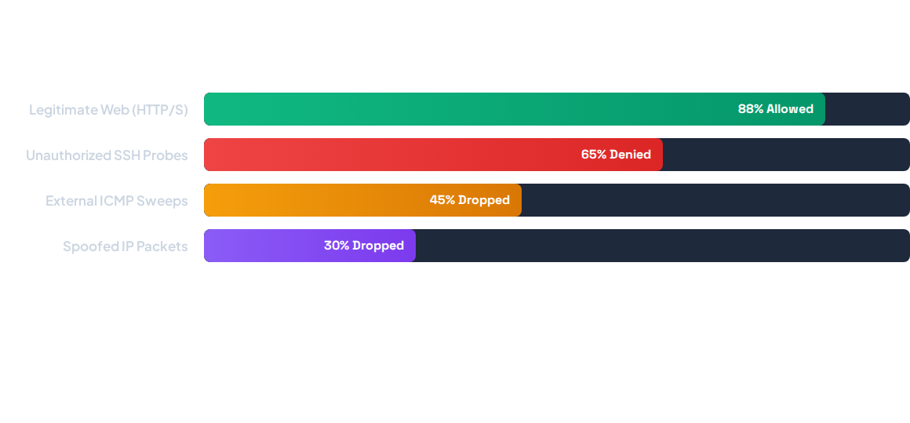
Lab Simulation: Filtered Traffic Results
Simulated Packet Filter Run: 88% of standard user web queries matched Rule 10 successfully. All unauthorized SSH probes on Port 22 and external ICMP reconnaissance were blocked by Rule 30 & 40, triggering automated SIEM alerts.

Slide 12

Questions & Lab Discussion
Review packet simulation logs, verify ACL sequence numbers, and test state table dynamics.

Slide 13


Image Sources
https://cdn.automationforum.co/uploads/2026/07/Top-Cybersecurity-Threat-Identification-Methods-Every-Security-Professional-Should-Know-2-1024x559.jpg
Source: automationforum.co
https://static.vecteezy.com/system/resources/previews/013/069/817/large_2x/vpn-secure-connection-concept-person-using-virtual-private-network-technology-to-create-encrypted-tunnel-to-remote-server-on-internet-to-protect-data-privacy-or-bypass-censorship-photo.jpg
Source: www.vecteezy.com

